Slide 1

Fine-Tuning a Large Language Model (LLM) for Text Classification
Applying Transfer Learning with DistilBERT for Sentiment Analysis
Presenter: Sourabh Khamankar

Slide 2
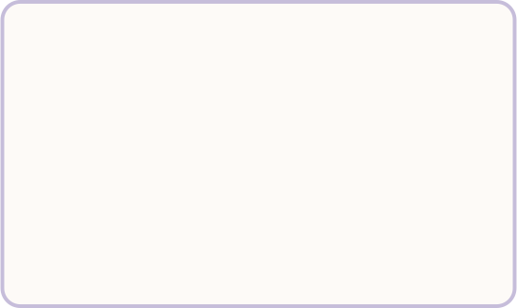
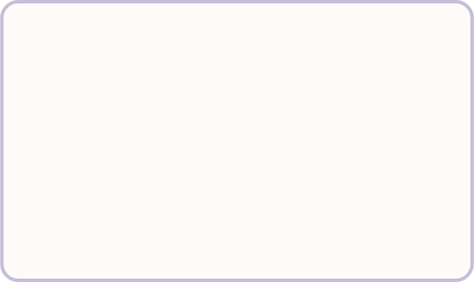
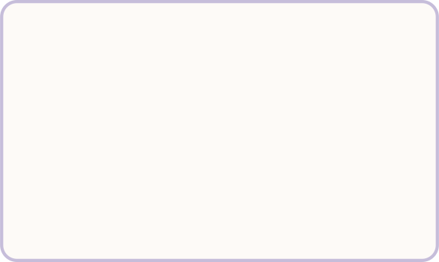
Project Overview & Objectives
Goal
Core Focus
The Advantage
Fine-tune a pre-trained LLM for binary sentiment classification.
Large Language Models (LLMs), Transfer Learning, and NLP Pipelines.
Leveraging transfer learning saves immense computational resources compared to training from scratch.

Slide 3
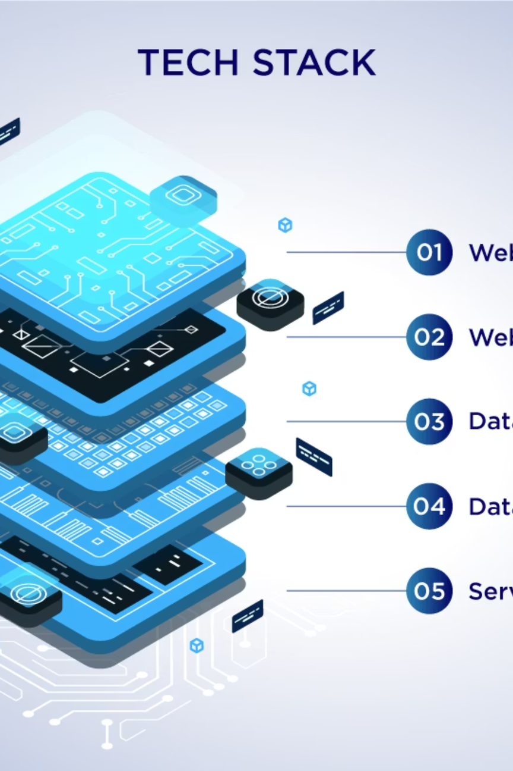
The Technology Stack
Model: distilbert-base-uncased (A lighter, faster version of BERT).
Frameworks: Hugging Face (Transformers, Datasets, Evaluate) and PyTorch.
Hardware: GPU-accelerated environment (NVIDIA CUDA 11.8).

Slide 4
The Dataset & Preprocessing
Dataset: IMDb Movie Review Dataset.
Volume: 25,000 training samples and 25,000 testing samples.
Preprocessing
Raw text converted to numerical tokens and attention masks using DistilBERT's AutoTokenizer with truncation and padding.

Slide 5

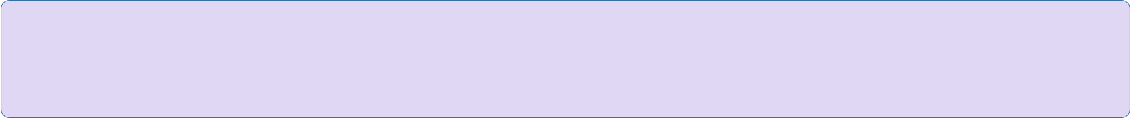
The Fine-Tuning Process
Hugging Face Trainer API
Hyperparameters
Duration
Learning rate of 2e-5, Batch size of 16, Weight decay of 0.01.
2 Epochs.
Utilized for optimized training.
Strategy
Monitored validation loss to automatically load the best model weights at the end.

Slide 6
Performance & Results
The model successfully adapted to the specific classification task with highly accurate results.
92.32%
92.14%
0.1977
Final Accuracy
Final F1-Score
Validation Loss

Slide 7

Live Inference Demo
The model successfully predicts sentiment on unseen, custom text.
Example 1: "The pacing was a bit slow, but the cinematography was absolutely breathtaking!" -> Predicted: Positive
Example 2: "I honestly couldn't wait for this movie to end. Terrible acting." -> Predicted: Negative

Slide 8
Strengths & Limitations of Pre-Trained LLMs
Strengths
Limitations
Highly accurate with small task-specific datasets
Out-of-the-box generalization
Massive time savings
Can be memory-intensive
May inherit biases from massive original training data
Operates as a "black box" lacking direct explainability

